Slide 1
USA Election | data analysis
An Analysis on the US Presidential Election from 2012 to 2016

Slide 2
Question
How did Donald Trump with the 2016 Election? Did his strategy work?

Slide 3
Research
Hillary Clinton
First Woman President??
First former First Lady??
Experienced/Qualified
Political
Scandal ridden
Lacks popularity
Donald Trump
Ultimate political outsider
Businessman, Real Estate Tycoon
Celebrity
Gauche, crude voice of the people
Simple message: America is in a bad place, I can make it great again
Nostalgia
Strategy:
Strategy:
Win woman, Win Hispanic, status quo
Win White, Win middle America

Slide 4
Hypothesis

Slide 5
Data sourcing
What data do we need?
County Election Data 2012 & 2016
County Demographics Data
Education
Economics
Race
What data is available?
County Presidential Election Returns 2012 & 2016
Election results for all 3,142 Counties/Parishes/Boroughs/10 census areas/41 independent cities, and the District of Columbia
Downloaded CSV
USA 2016 Presidential Election by County 2016
Election results for all 3,142 counties with demographic data for each county
Income data
Downloaded CSV

Slide 6
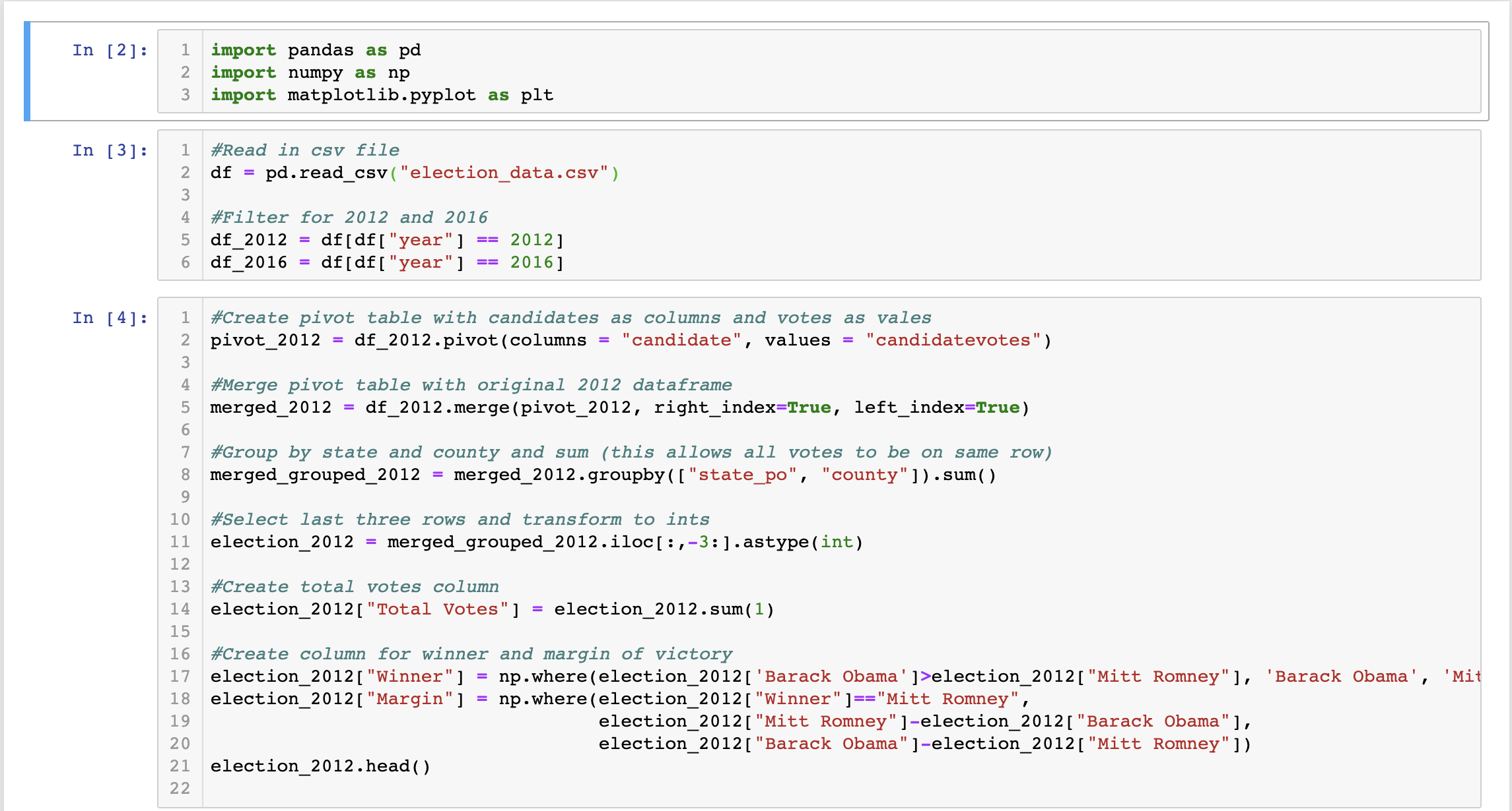
Data wrangling | Election Results 2012

Slide 7
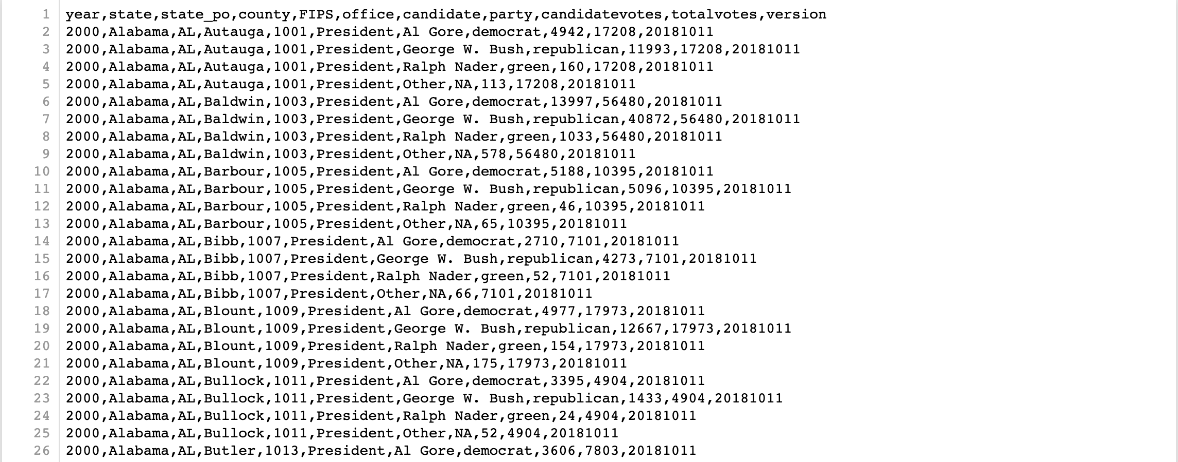
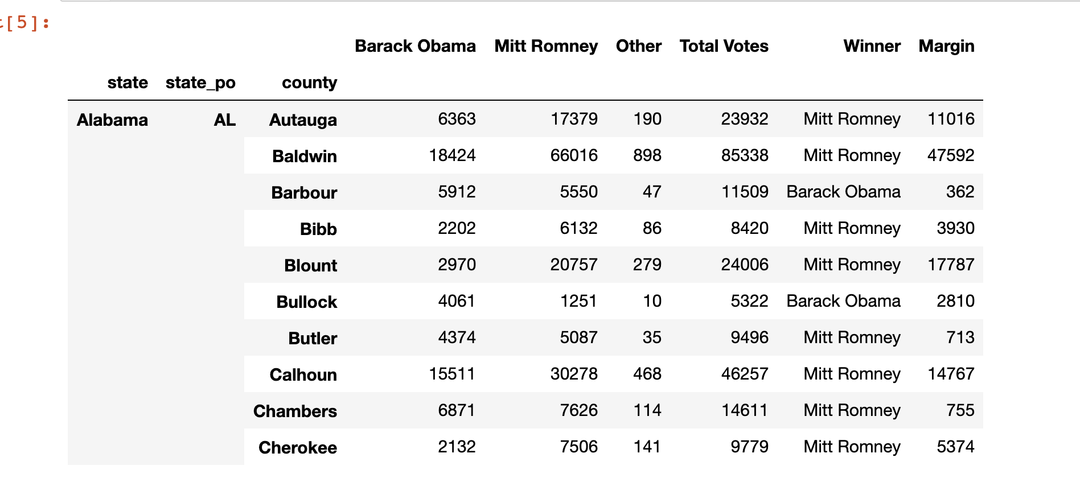
Before
After
Figure 2: Election Data 2012
Figure 1: 2000 – 2016 Election Data CSV File

Slide 8
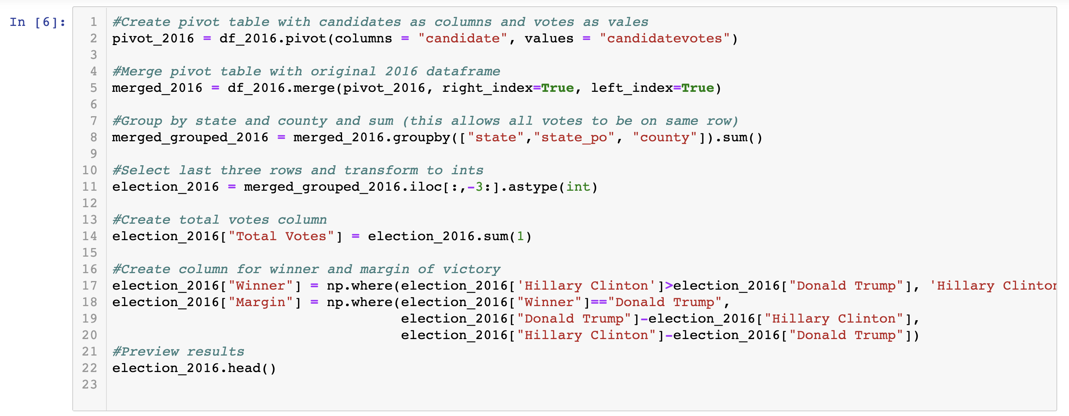
Data Wrangling | election results 2016

Slide 9
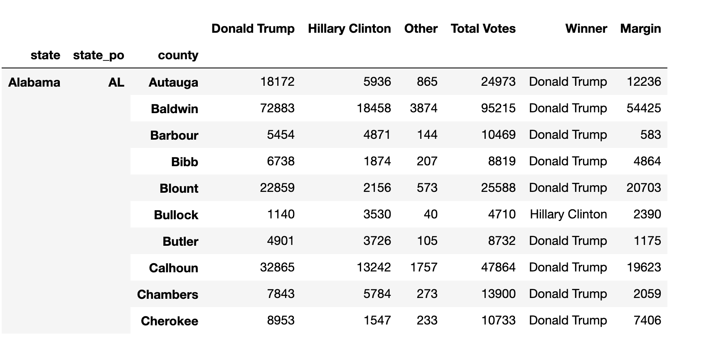
Election Data 2016 Df

Slide 10
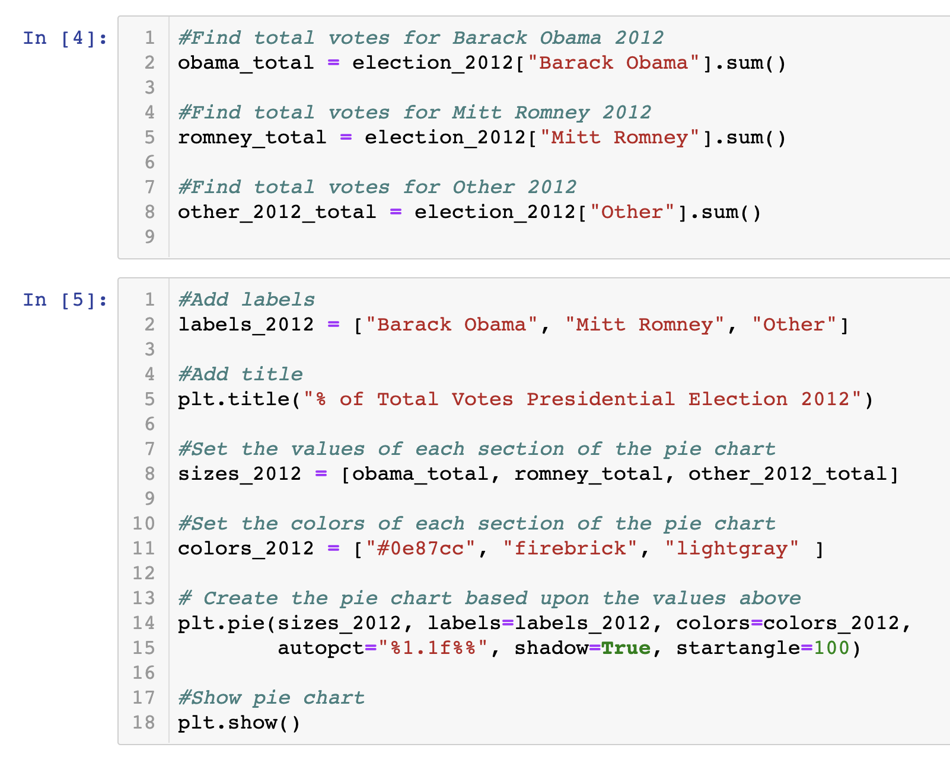
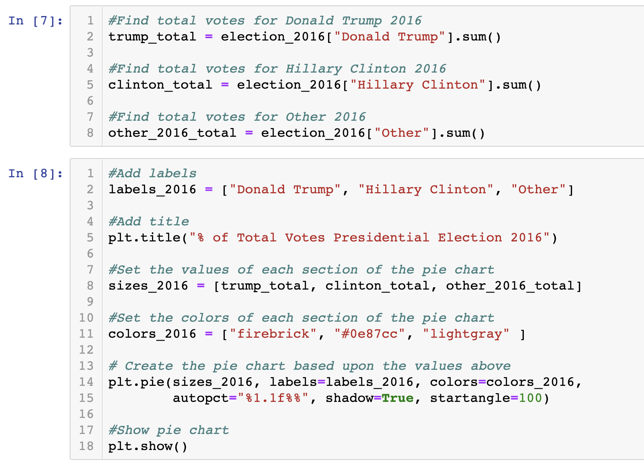
Pie Charts 2012 & 2016 - code

Slide 11
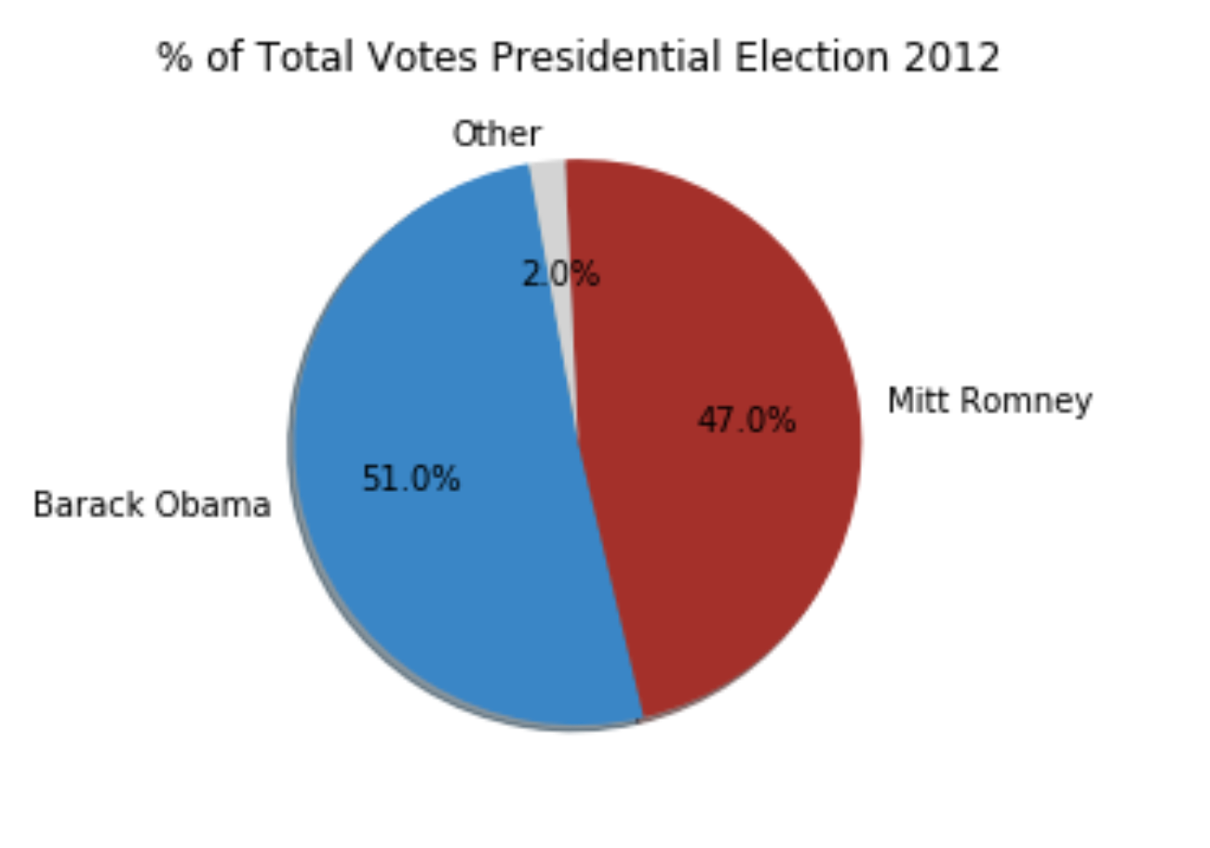
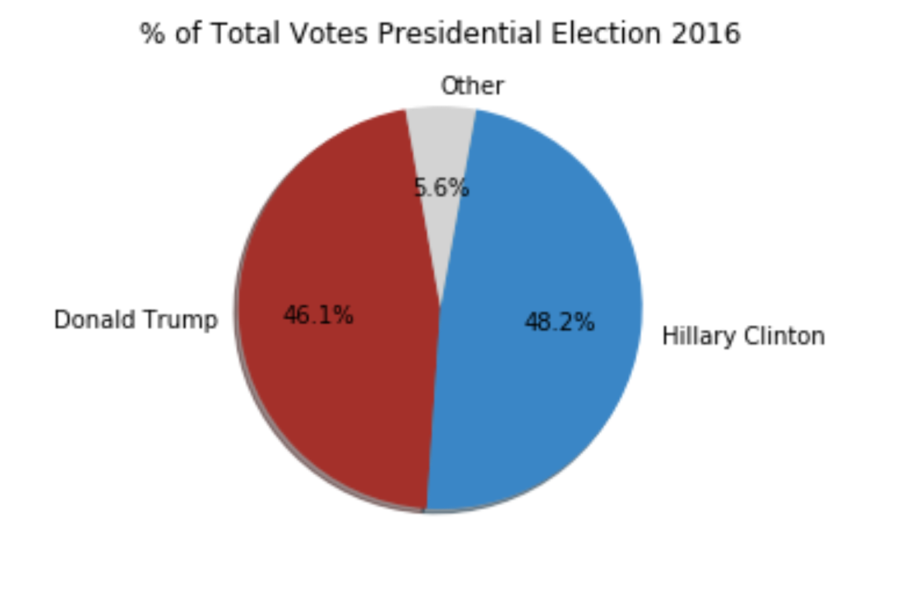
Pie Charts 2012 & 2016 - Visual

Slide 12
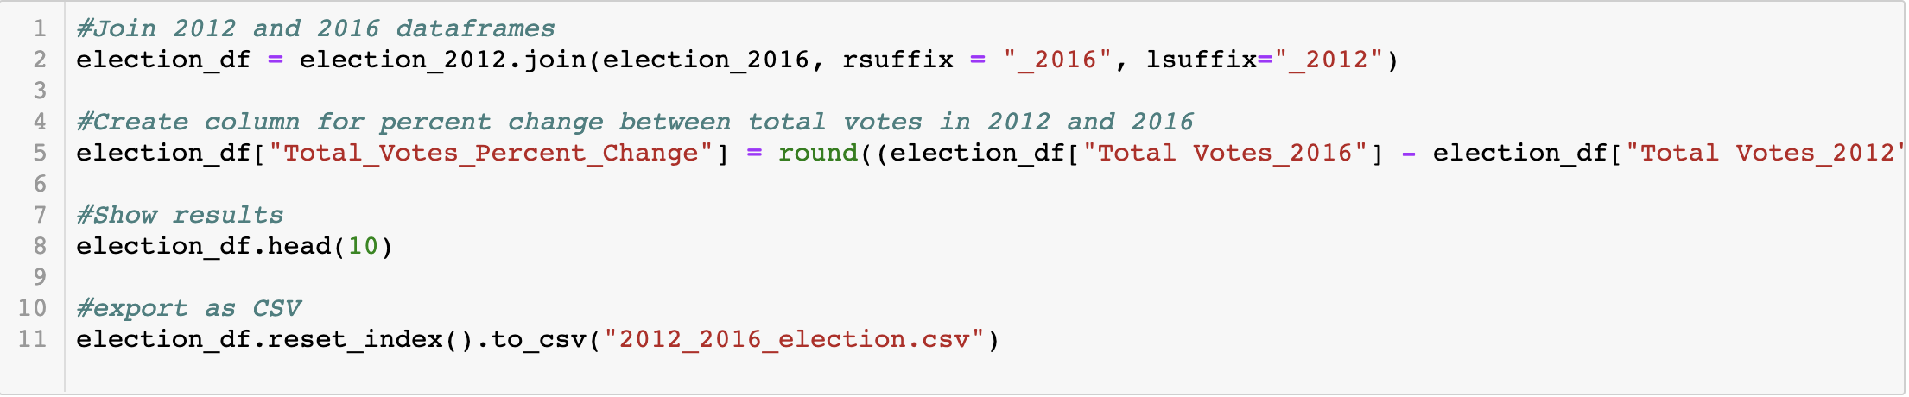
Data Merge | 2012 & 2016

Slide 13
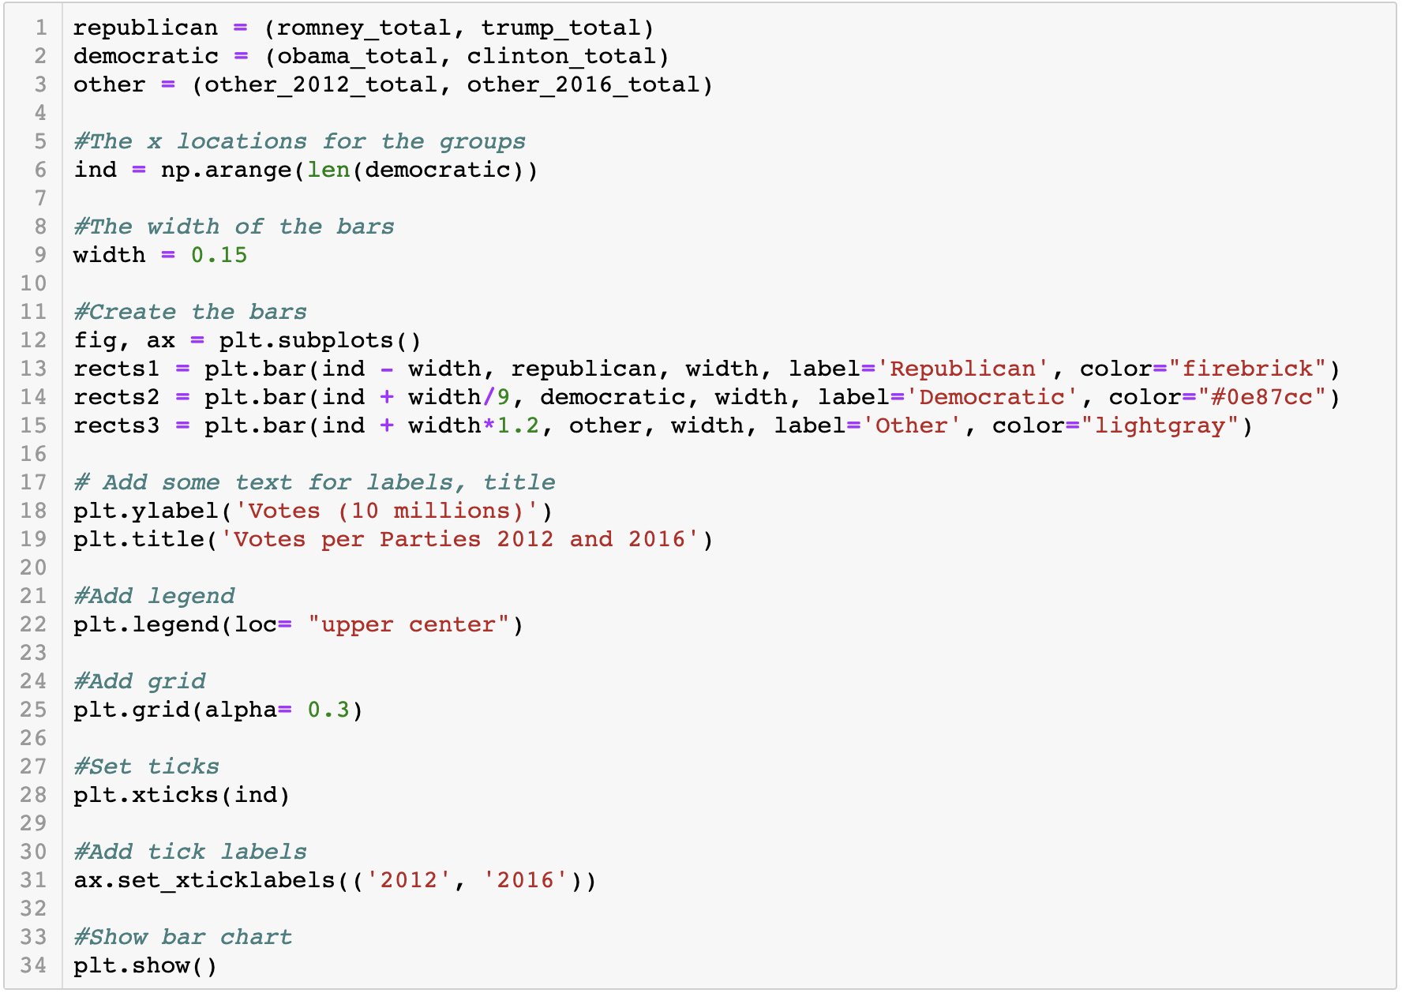
Bar Graph 2012 & 2016 - Code

Slide 14
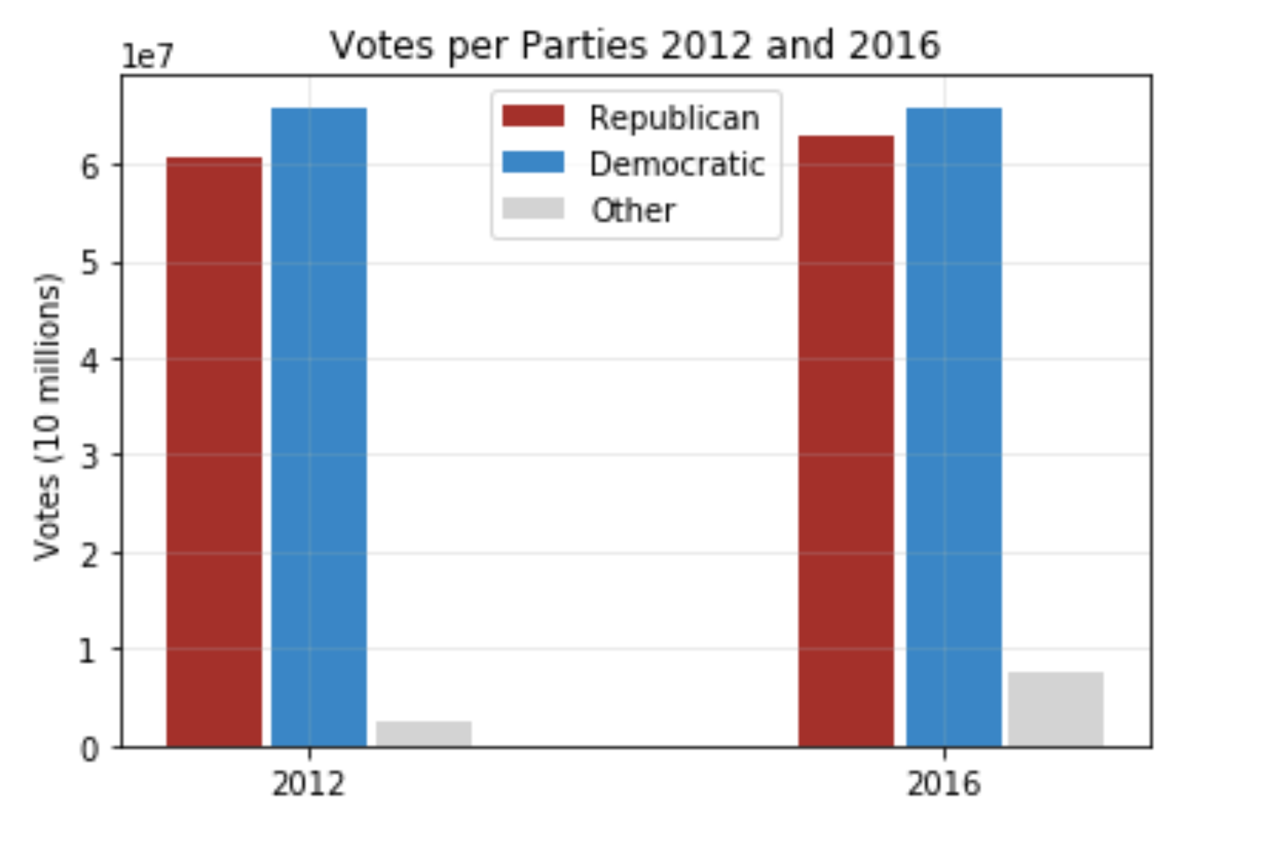
Bar Graph 2012 & 2016 - Visual

Slide 15
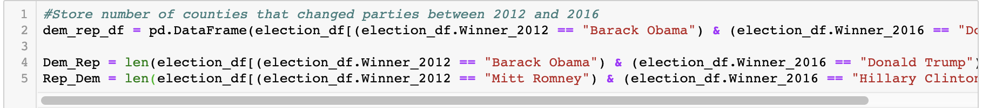
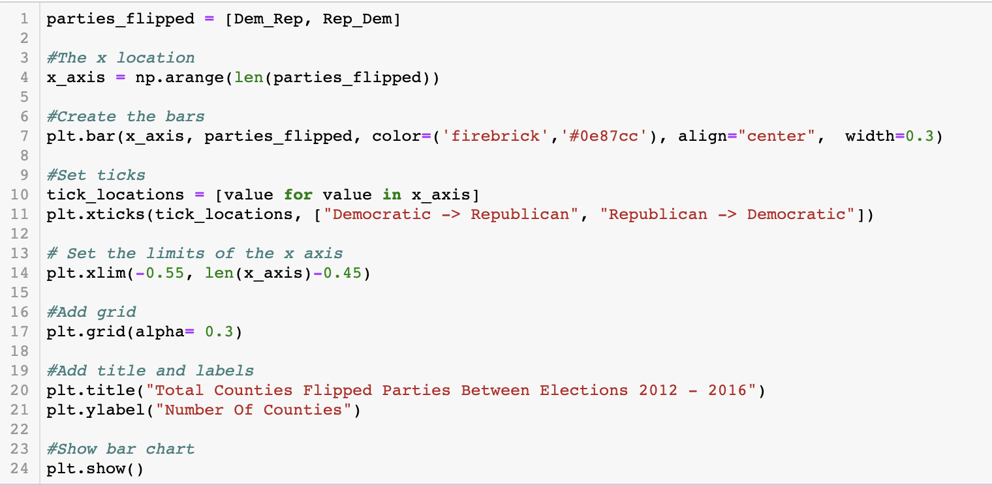
Bar Graph | Swing Counties - Code

Slide 16
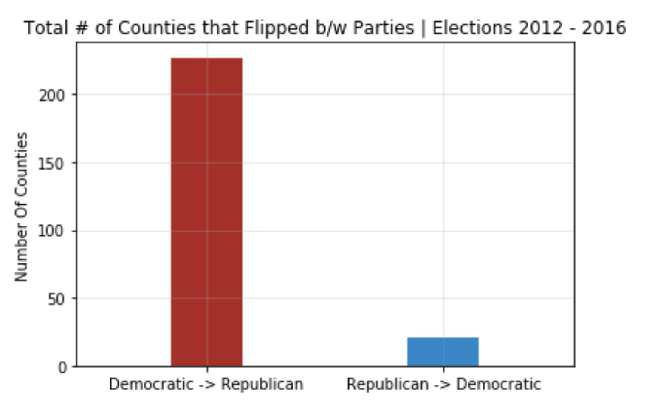
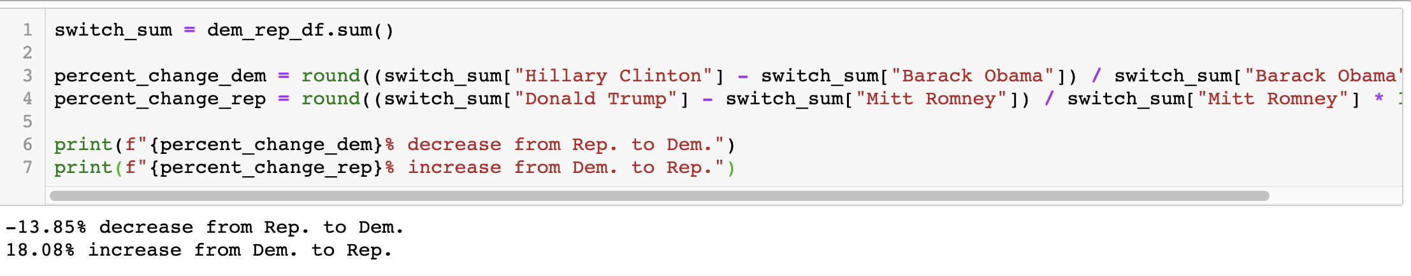
Total # of Counties that Flipped - Visual

Slide 17
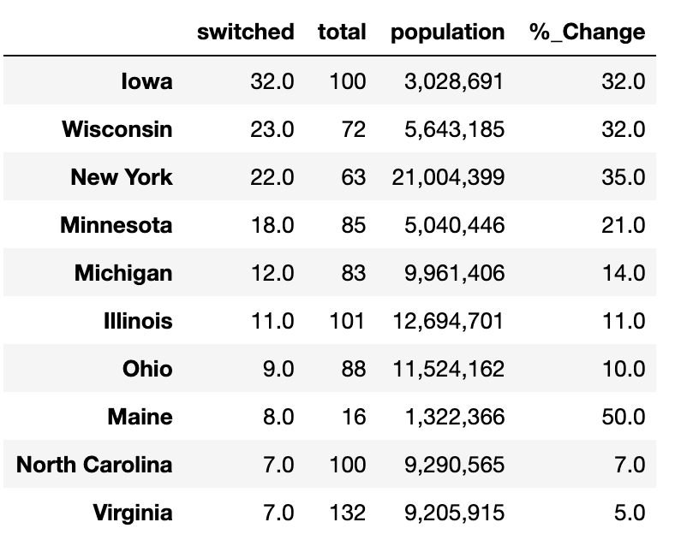
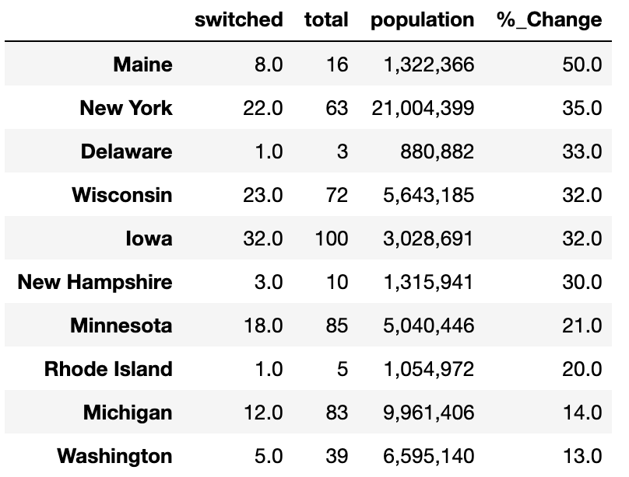
Counties that Flipped Dem. To Rep - Table
Table 1: Top Ten States with the most “Flipped” Counties
Table 2: Top Ten States with the largest % Change in “Flipped” Counties

Slide 18
Election map | Context
TRUMP SWING STATES 2016:
PA – 20
OH – 18
MI – 16
WI – 10
IA – 6
AZ – 11
FL – 29
NC – 15
CLINTON SWING STATES 2016
CO – 9
NV - 6
NH – 4
VA – 13

Slide 19
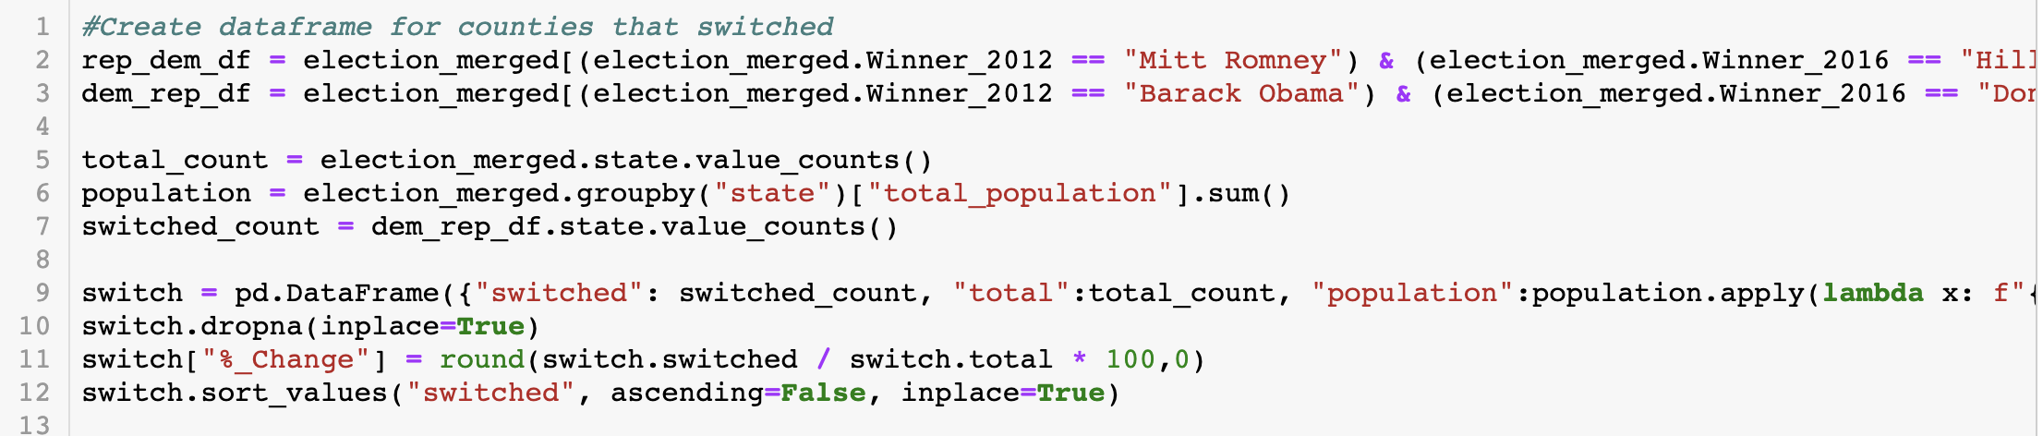
Total # of Counties that Flipped - Code

Slide 20
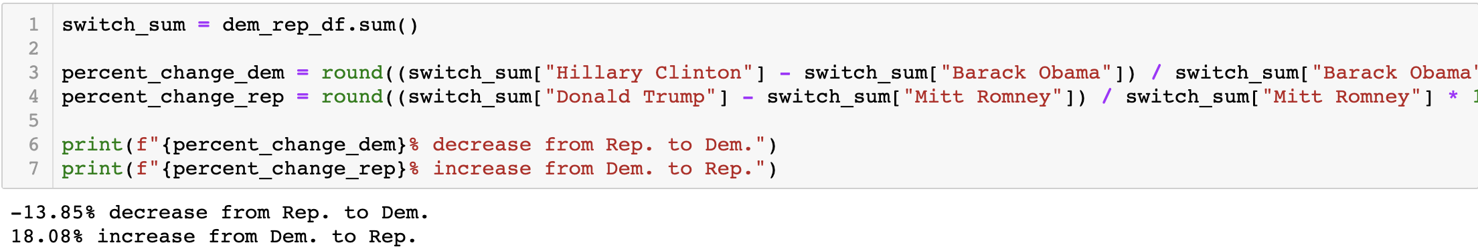
Percentage change in Counties that Flipped

Slide 21
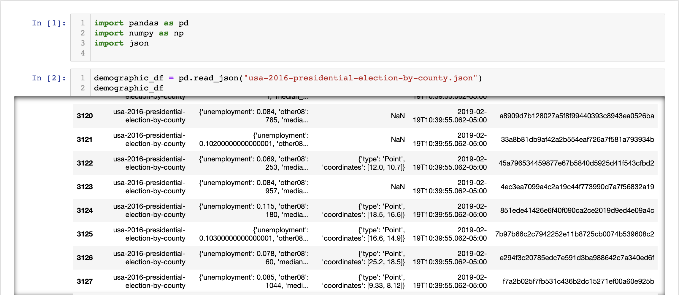
Data Strangling | Demographics

Slide 22
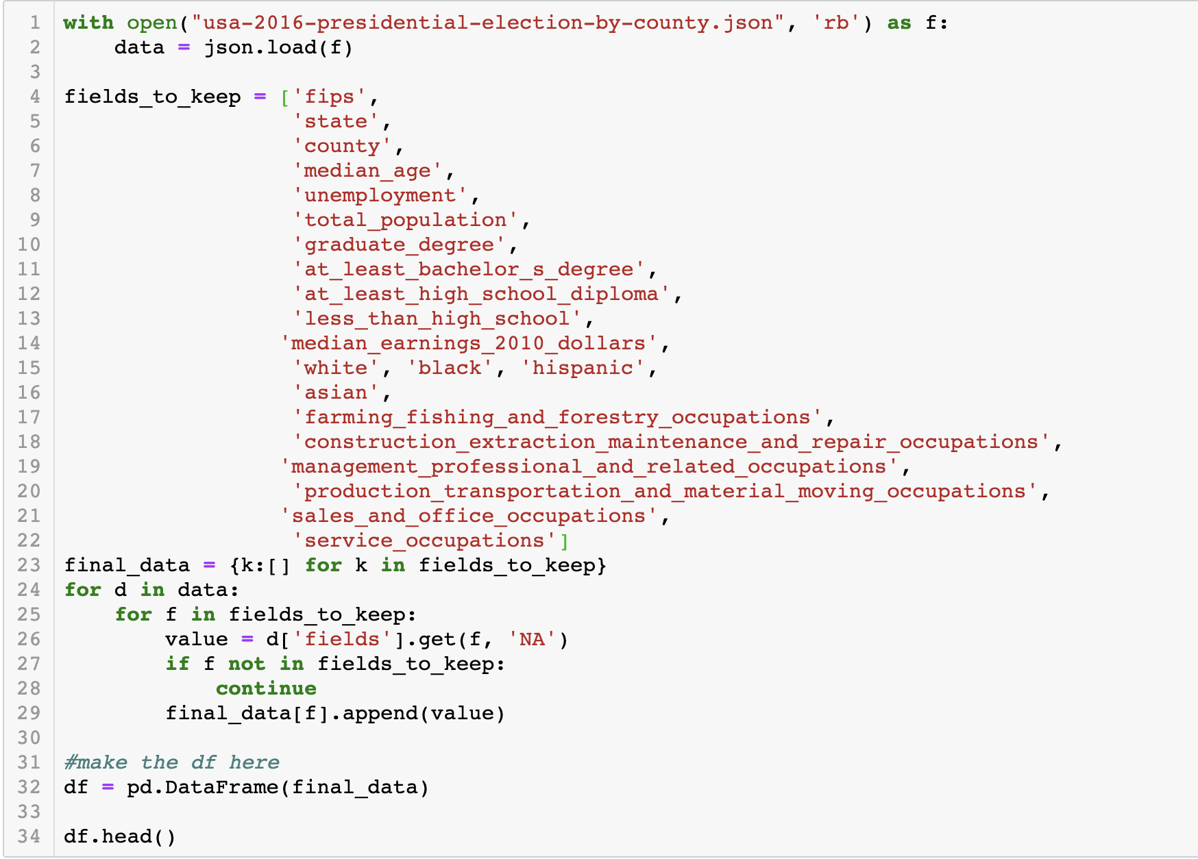
DATA Wrangling | demographics

Slide 23
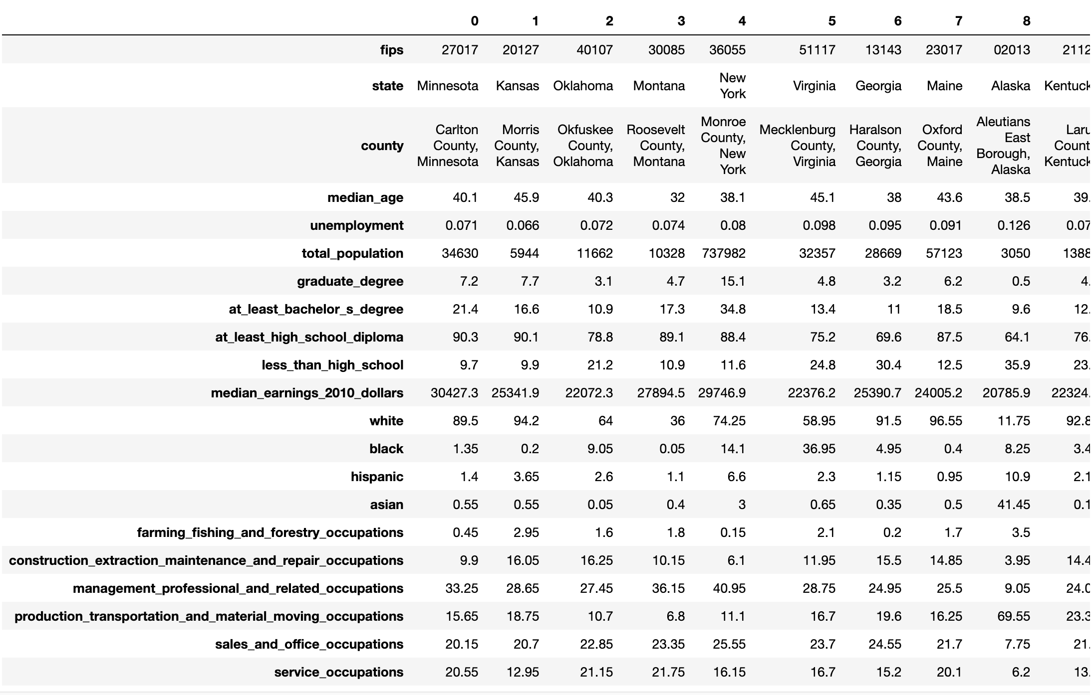
DATA Wrangling | demographics

Slide 24
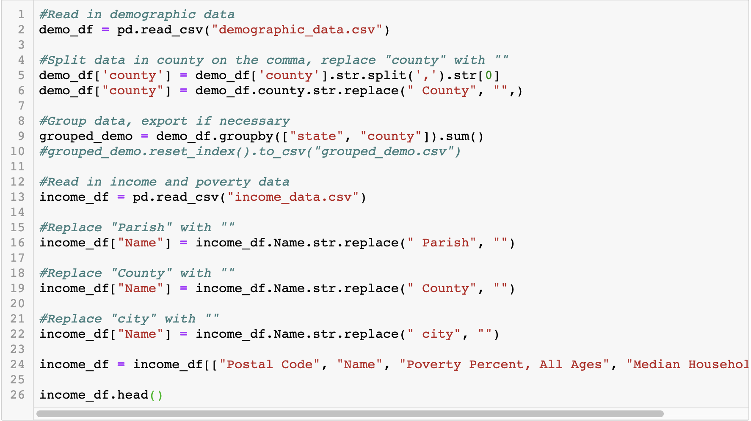
Data Clean | Election data x demographics

Slide 25
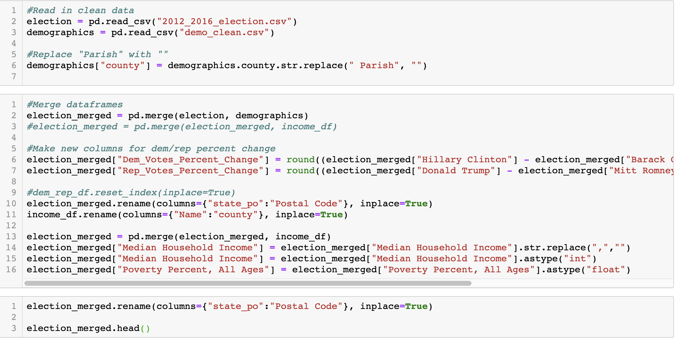
Data Clean | Election data x demographics

Slide 26
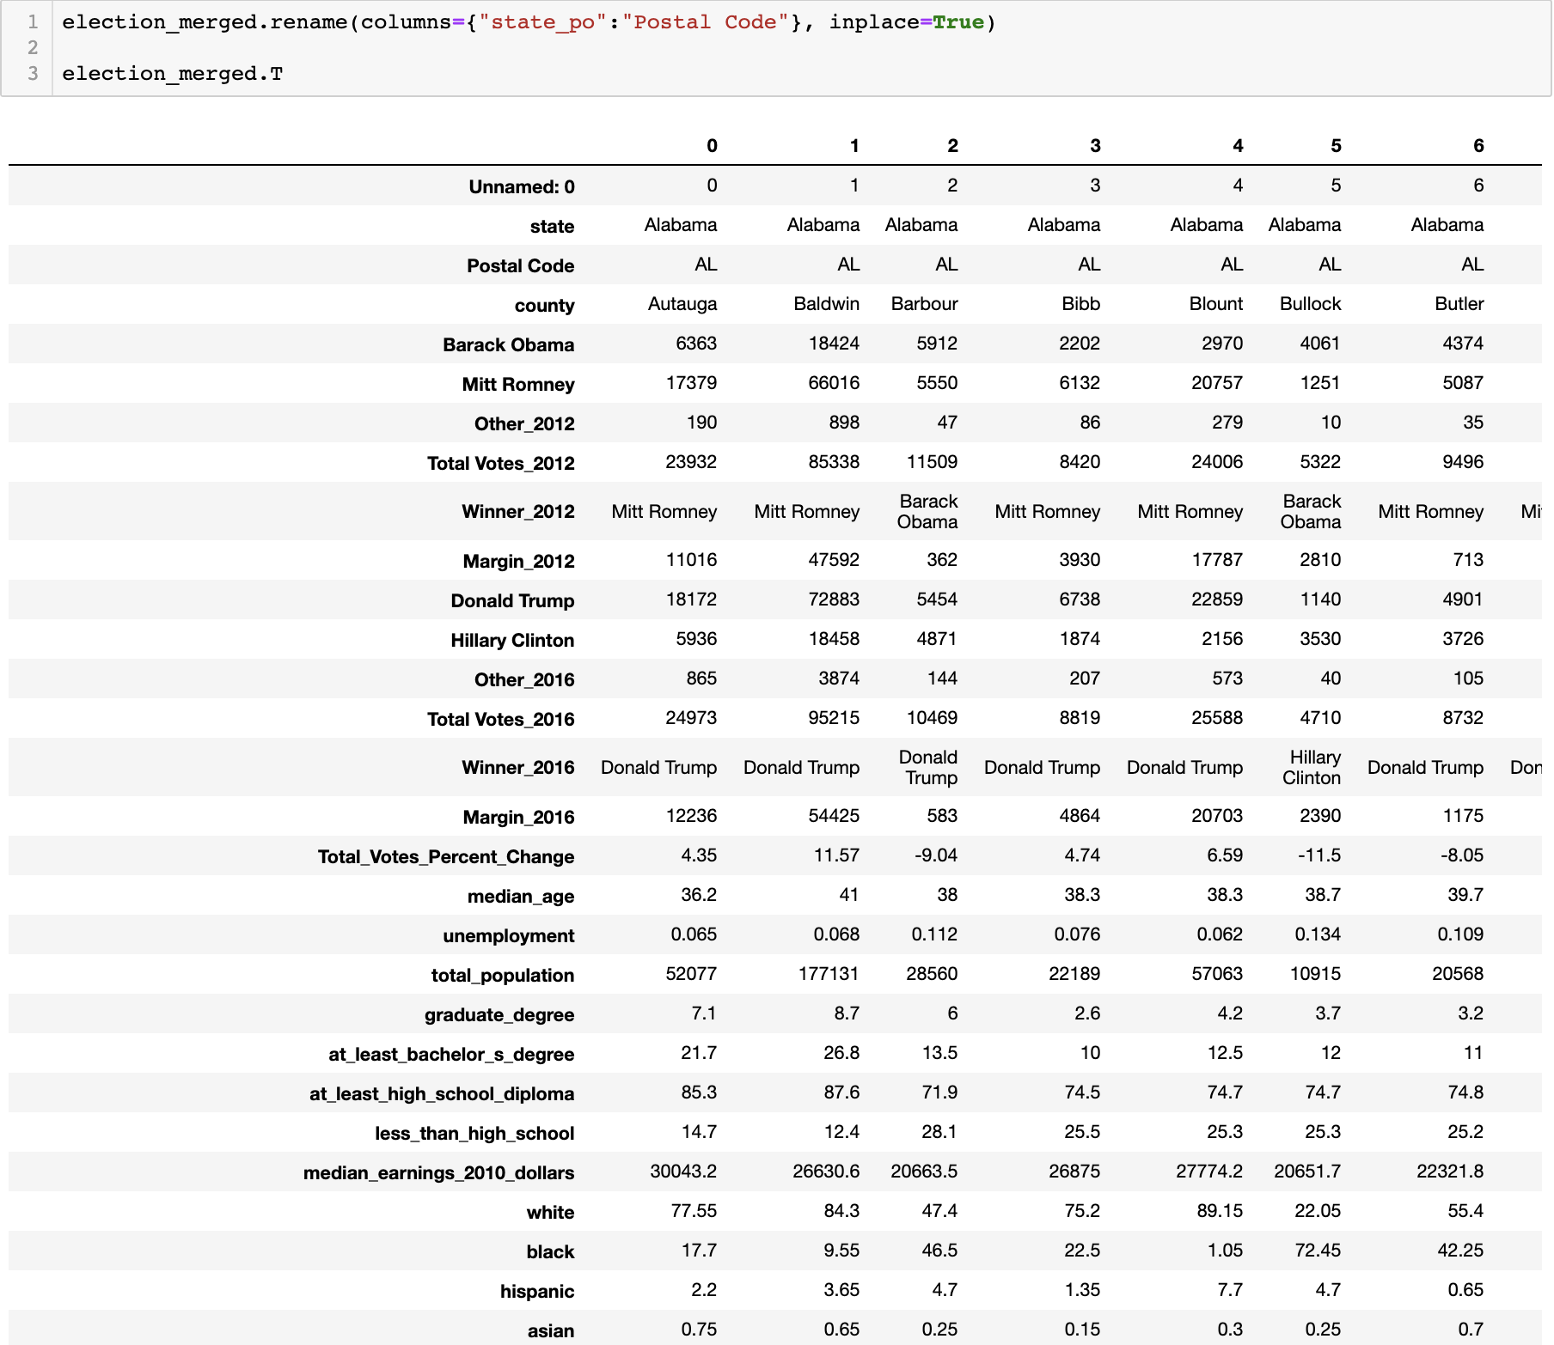
Data Merge | Election data x demographics

Slide 27
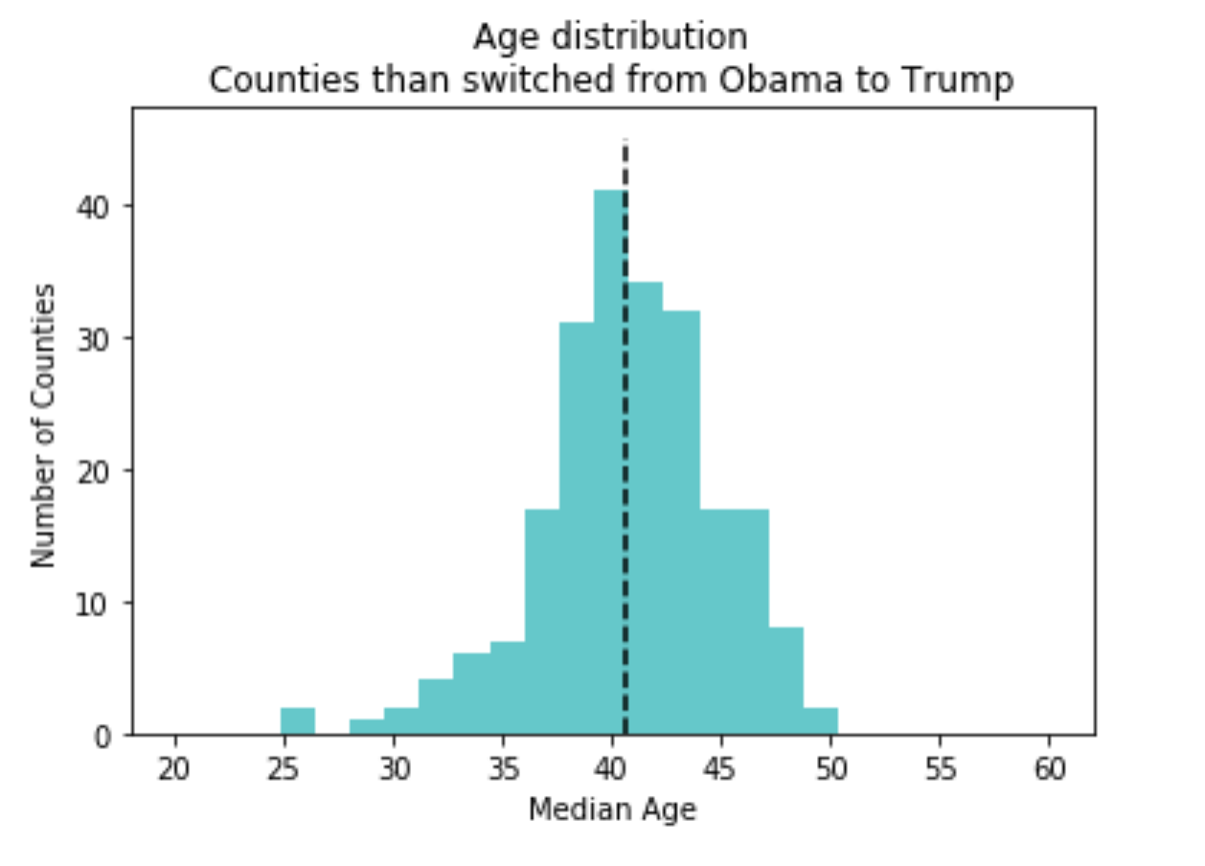
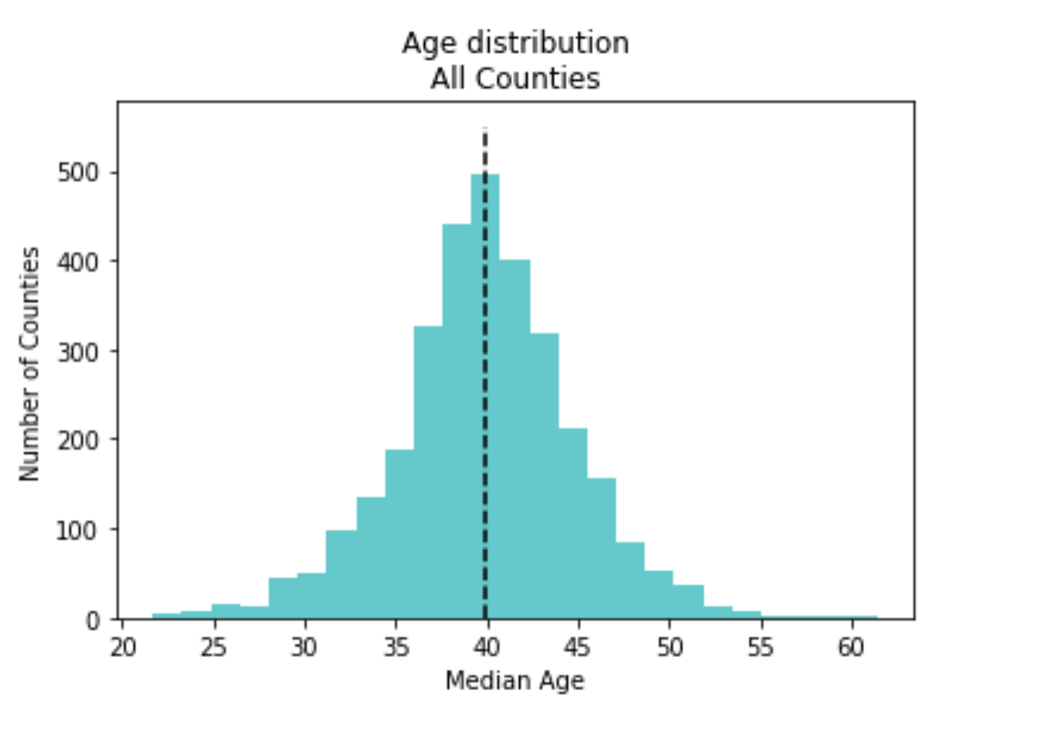
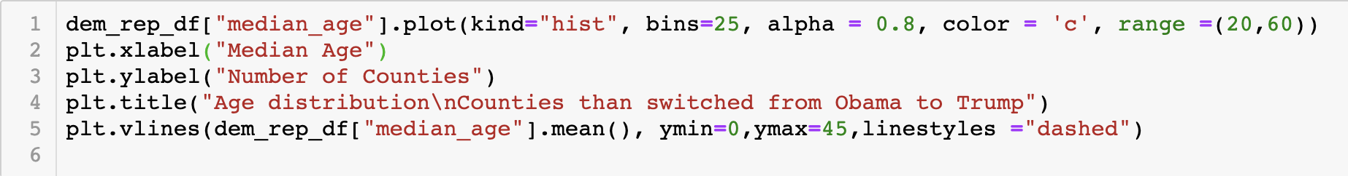
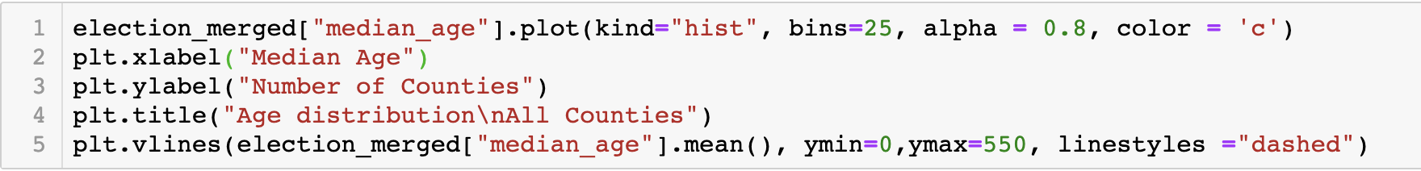
Election data x demographics – AGE Distribution

Slide 28
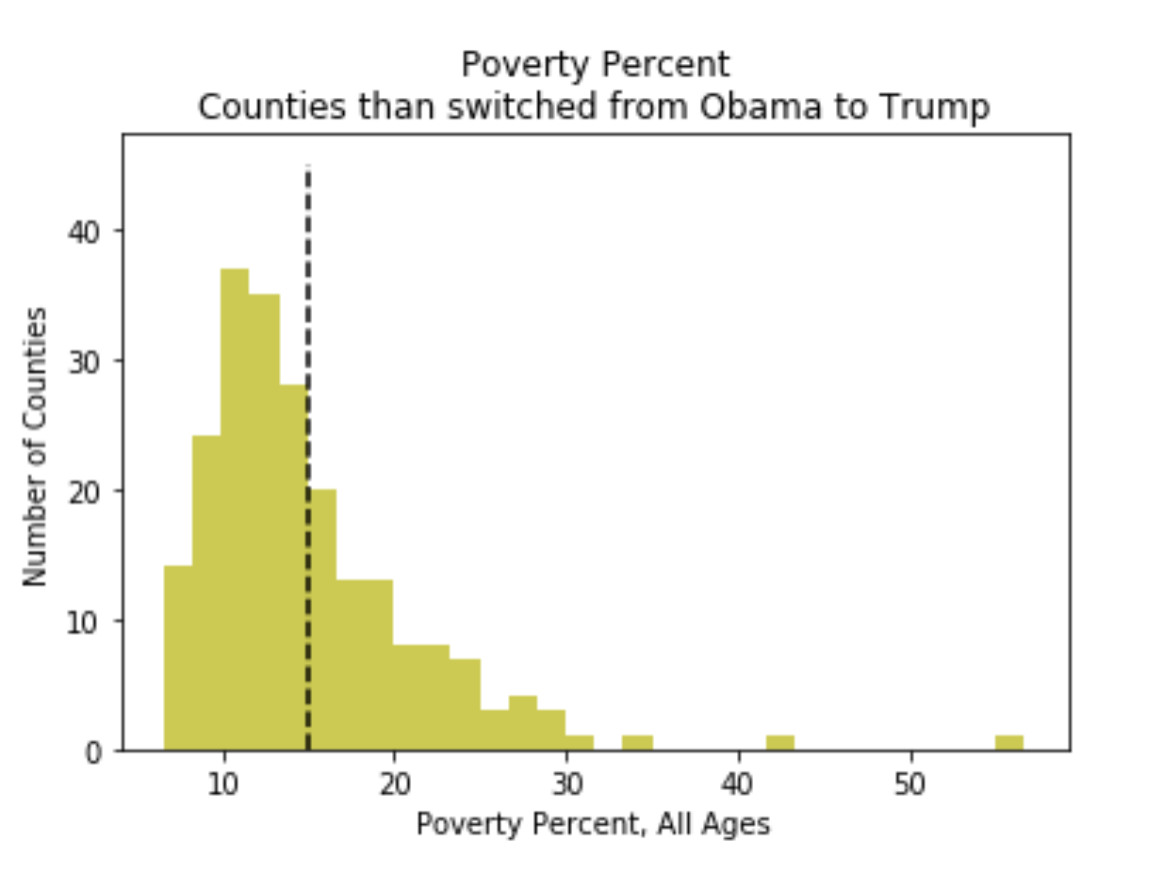
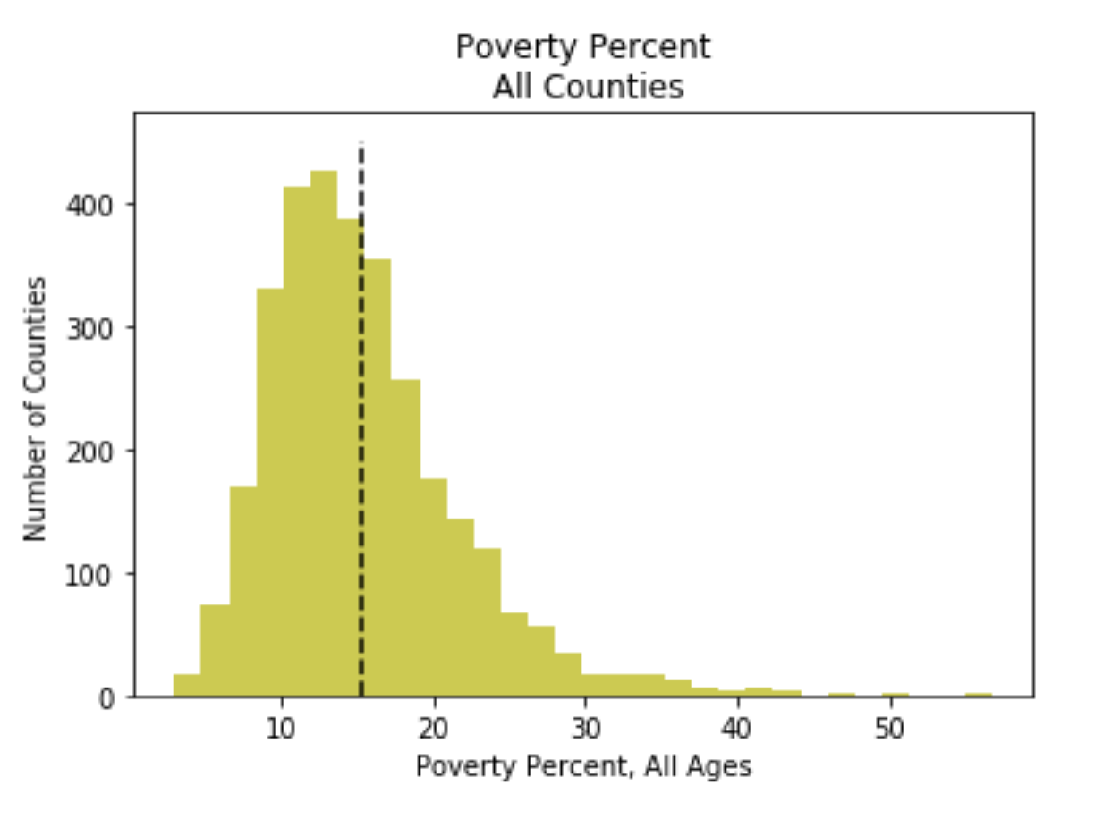
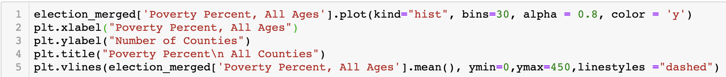
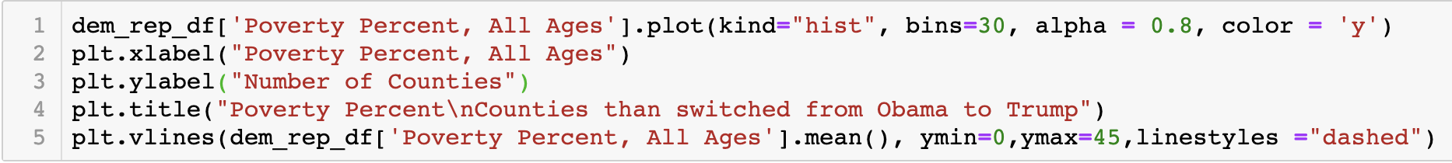
Election data x demographics

Slide 29
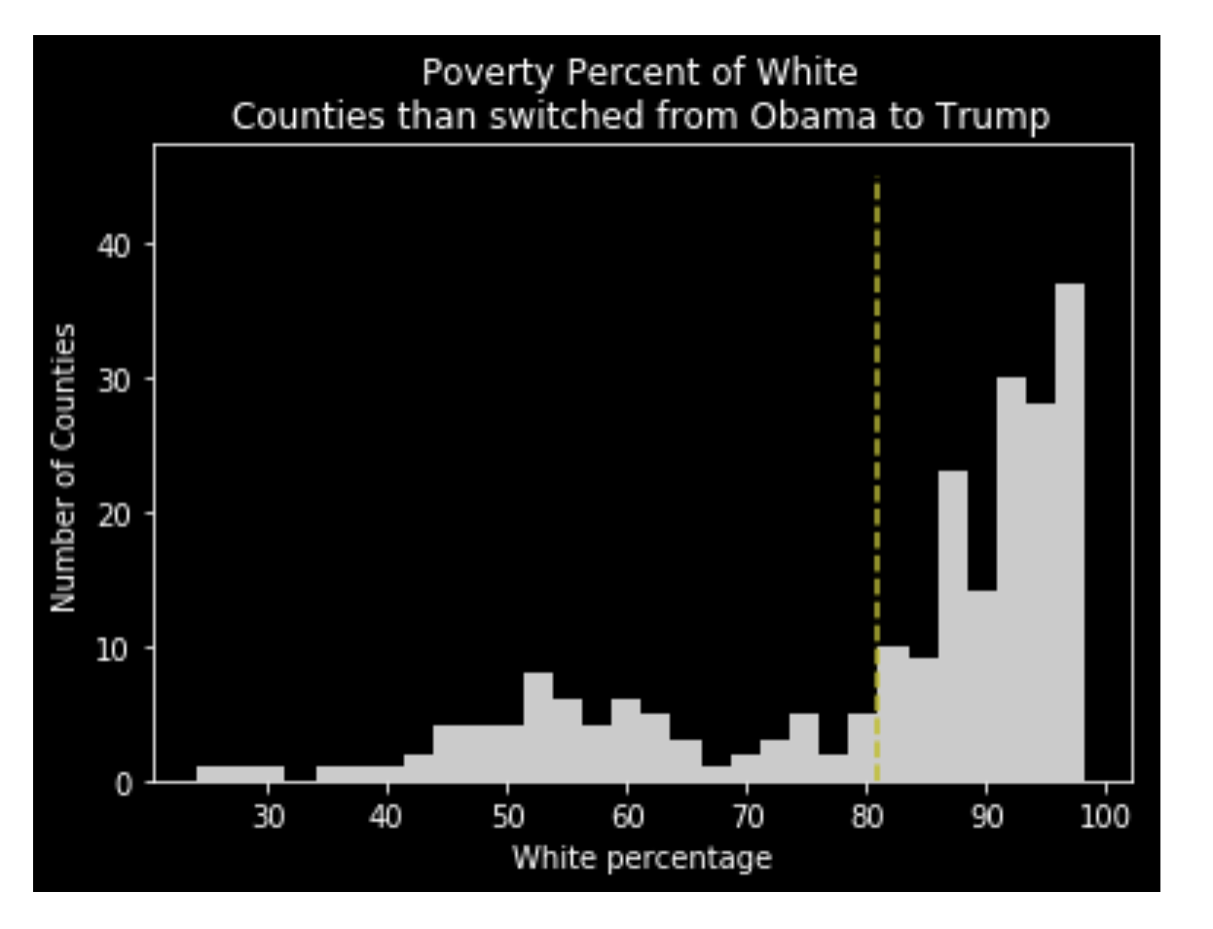
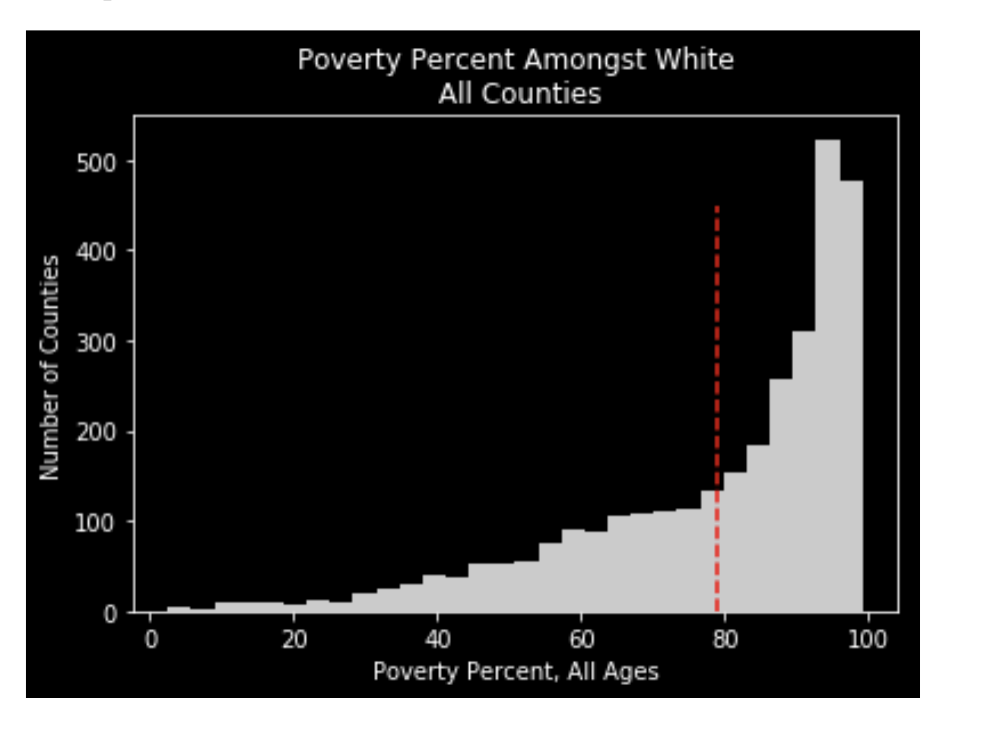
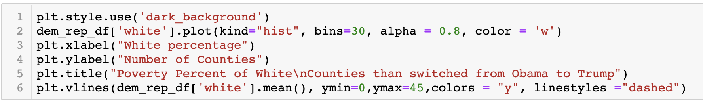
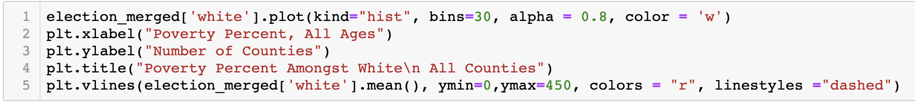
Election data x demographics

Slide 30
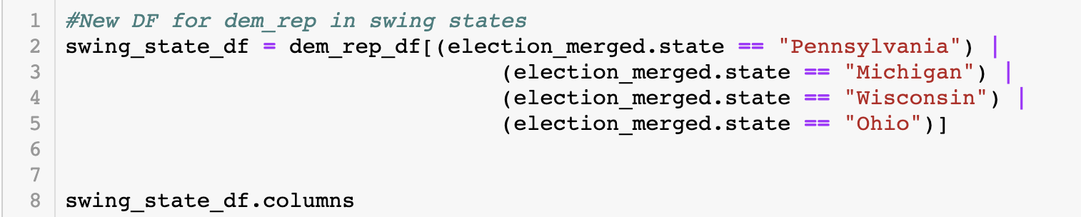
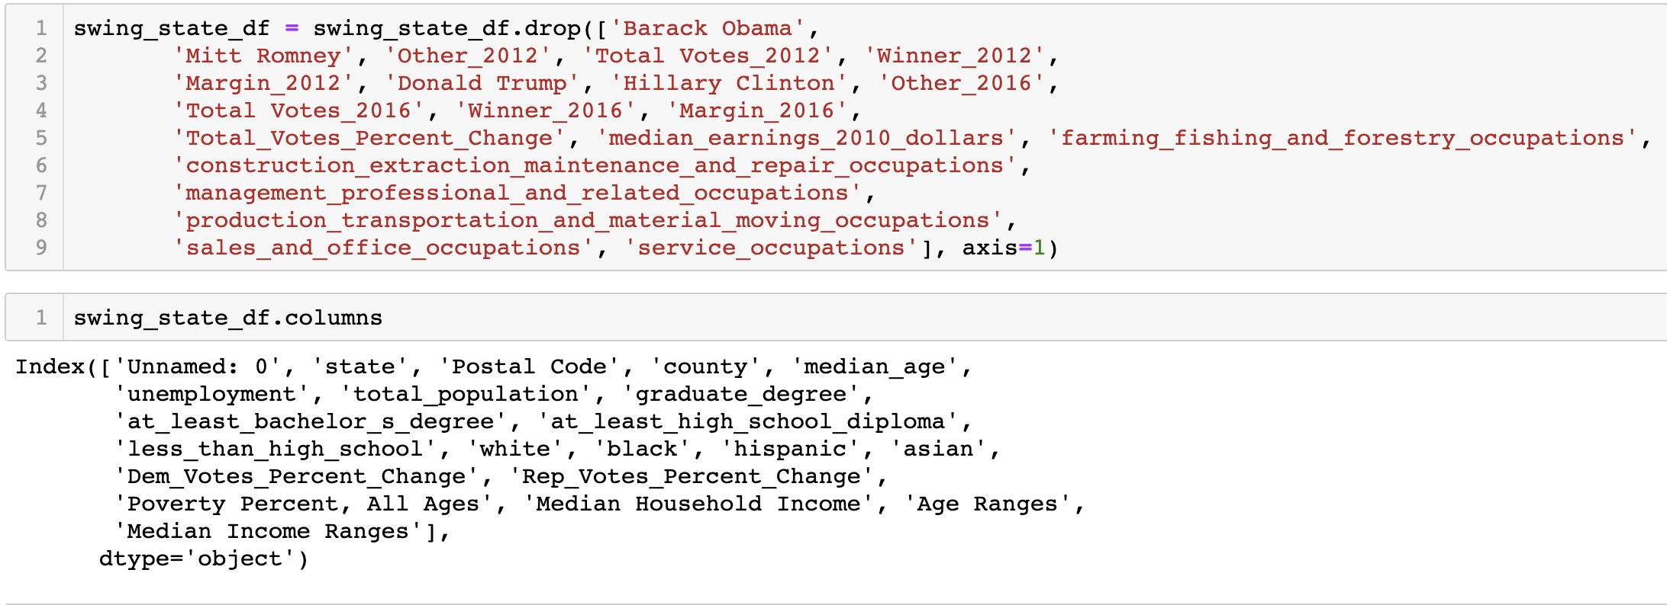
Election data x demographics

Slide 31
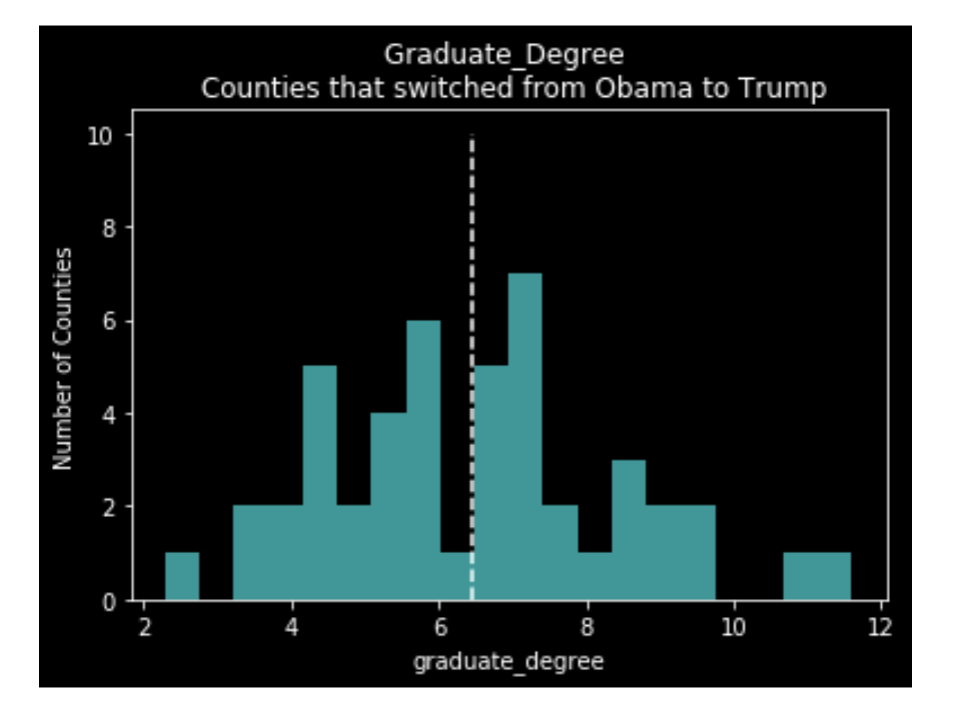
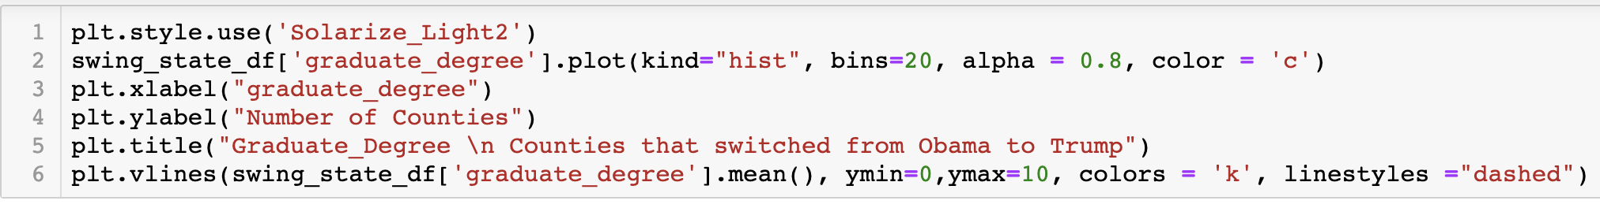
Election data x demographics

Slide 32
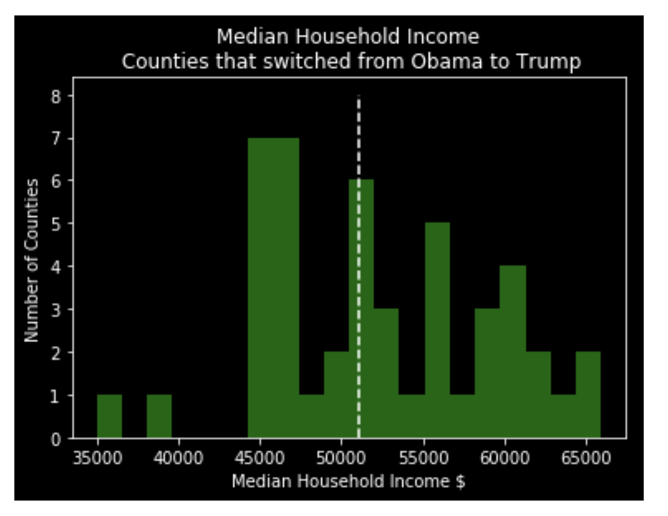
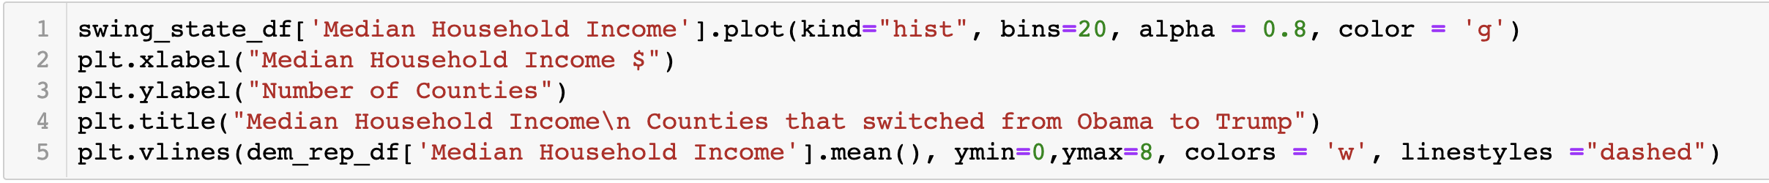
Election data x demographics

